Slide 1
LECTURE 02:
MENTAL MODELS AND VISUAL PERCEPTION
February 23, 2021
SDS 235
Visual Analytics

Slide 2





Announcements 1/2
Presidential Colloquium Speaker TONIGHT!

Slide 3


Announcements 2/2
Welcoming two new professors to Smith CSC!
Shinyoung Cho
(she / her) Network Security
Johanna Brewer
(they / them) Technology Design Activist

Slide 4


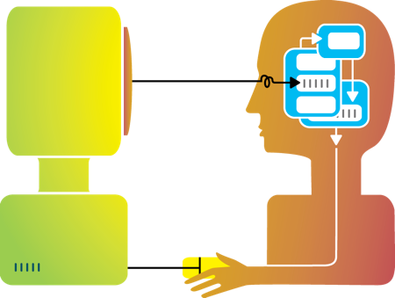
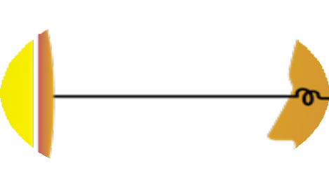





Last class
Humans and machines have complimentary strengths
Visualization
Perception
and context
Interaction
Computational power
Image credit: Ali Ansari

Slide 5


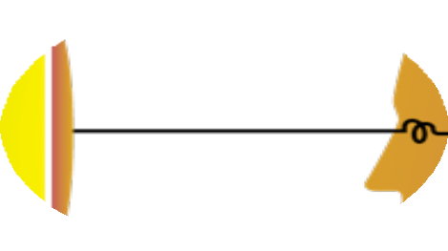

Visualization helps shape mental models
Visualization

Slide 6

The 9-dot Problem
Task 1: Connect all 9 dots using only straight lines

Slide 7
The 9-dot Problem
Task 2: Connect all 9 dots using 4 straight lines

Slide 8
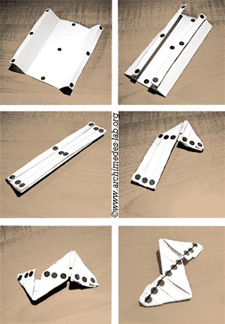
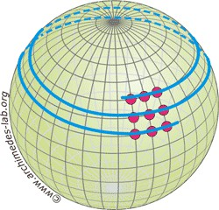
The 9-dot Problem
Task 4: Connect all 9 dots using 1 straight line

Slide 9



Mental Models: a Sketch

Slide 10
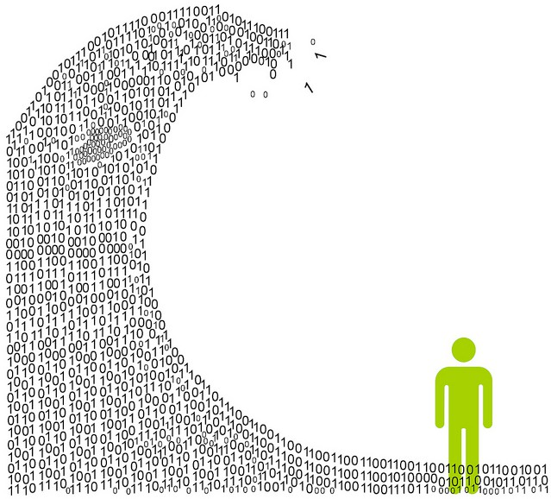
Information overload
We are exposed to huge amounts of information all the time
So much, in fact, that we can’t process it all fast enough

Slide 11

Mental models
To cope, we construct mental models: abstracted, simplified versions of the world that are more manageable

Slide 12







Mental models
Question:
How do we manage to navigate the world?

Slide 13
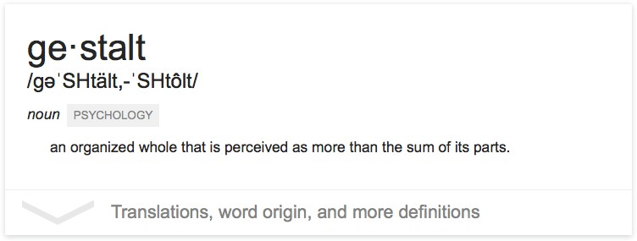
The “gestalt effect”
Our brain’s ability to generate whole forms, instead of just collections of unrelated elements

Slide 14


1. Reification
Demonstration of reification in perception from Lehar S. (2003) The World In Your Head, Lawrence Erlbaum, Mahwah, NJ. p. 52, Fig. 3.3

Slide 15


2. Emergence
Life Magazine: 58;7 1965-02-19, p 120. Photographer: Ronald C James

Slide 16
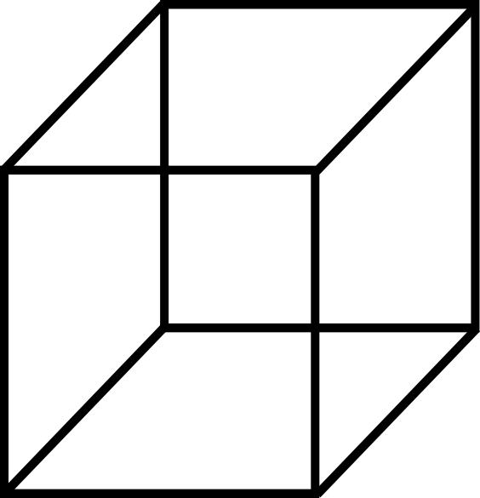
3. Multistability

Slide 17
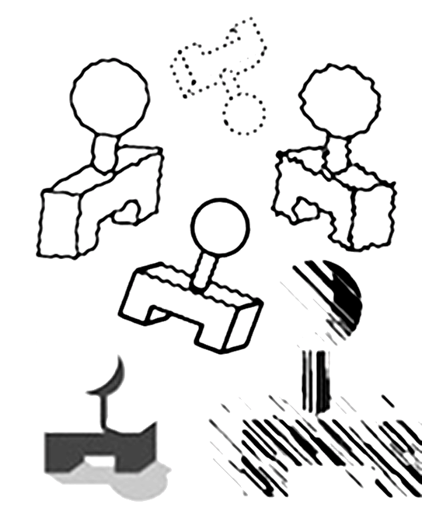

4. Invariance
Demonstration of invariance in perception from Lehar S. (2003) The World In Your Head, Lawrence Erlbaum, Mahwah, NJ. p. 53, Fig. 3.5

Slide 18
Mental models
A few
consequences...

Slide 19
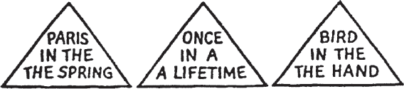
1. We tend to see what we expect to see

Slide 20
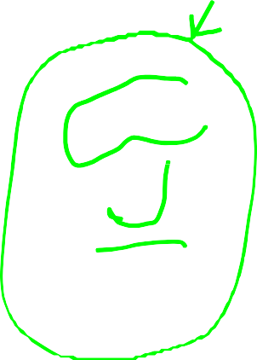
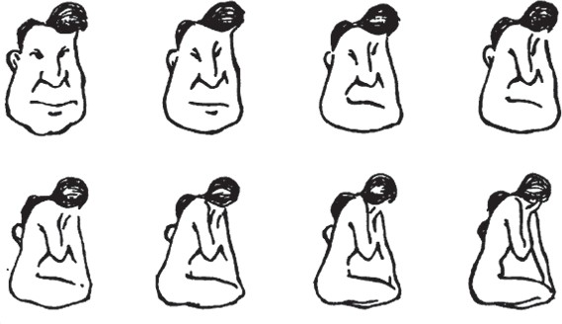


2. Mental models form quickly, & update slowly

Slide 21
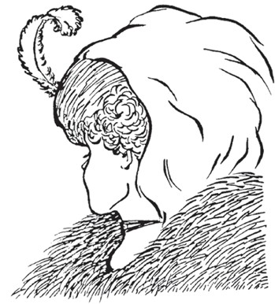

3. New information gets incorporated into the existing model

Slide 22
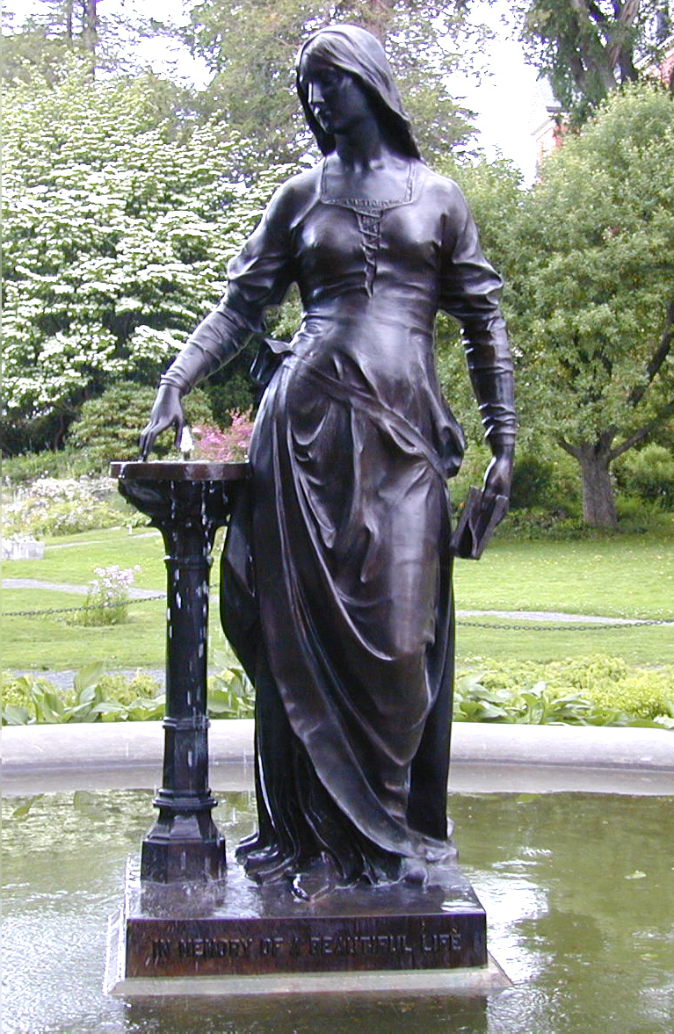
4. Initial exposure interferes with accurate perception
Blur size
128px 64px 32px 16px 8px None

Slide 23
The good, the bad, and the ugly…
The good:
Well-tuned mental models let us process information quickly
Frees up more processing power to synthesize information
The bad:
People (esp. experts) tend not to notice information that contradicts their mental model
A “fresh pair of eyes” can be beneficial
The ugly:
Mental models are unavoidable: everyone has them, and they’re all different
Key: be aware of how mental models form, how they shape perception, and how to support (or challenge) them

Slide 24

Hacking the brain
Question: what makes all this mental model stuff useful to us (designers and readers of data)?
Answer: in order to understand how people interpret and make sense of data, we need to know what cues we’re picking up on – and how to situate those cues within a larger framework

Slide 25


Visual perception (def.)
the (sometimes imperfect)
process by which we
detect and interpret
visual signals

Slide 26
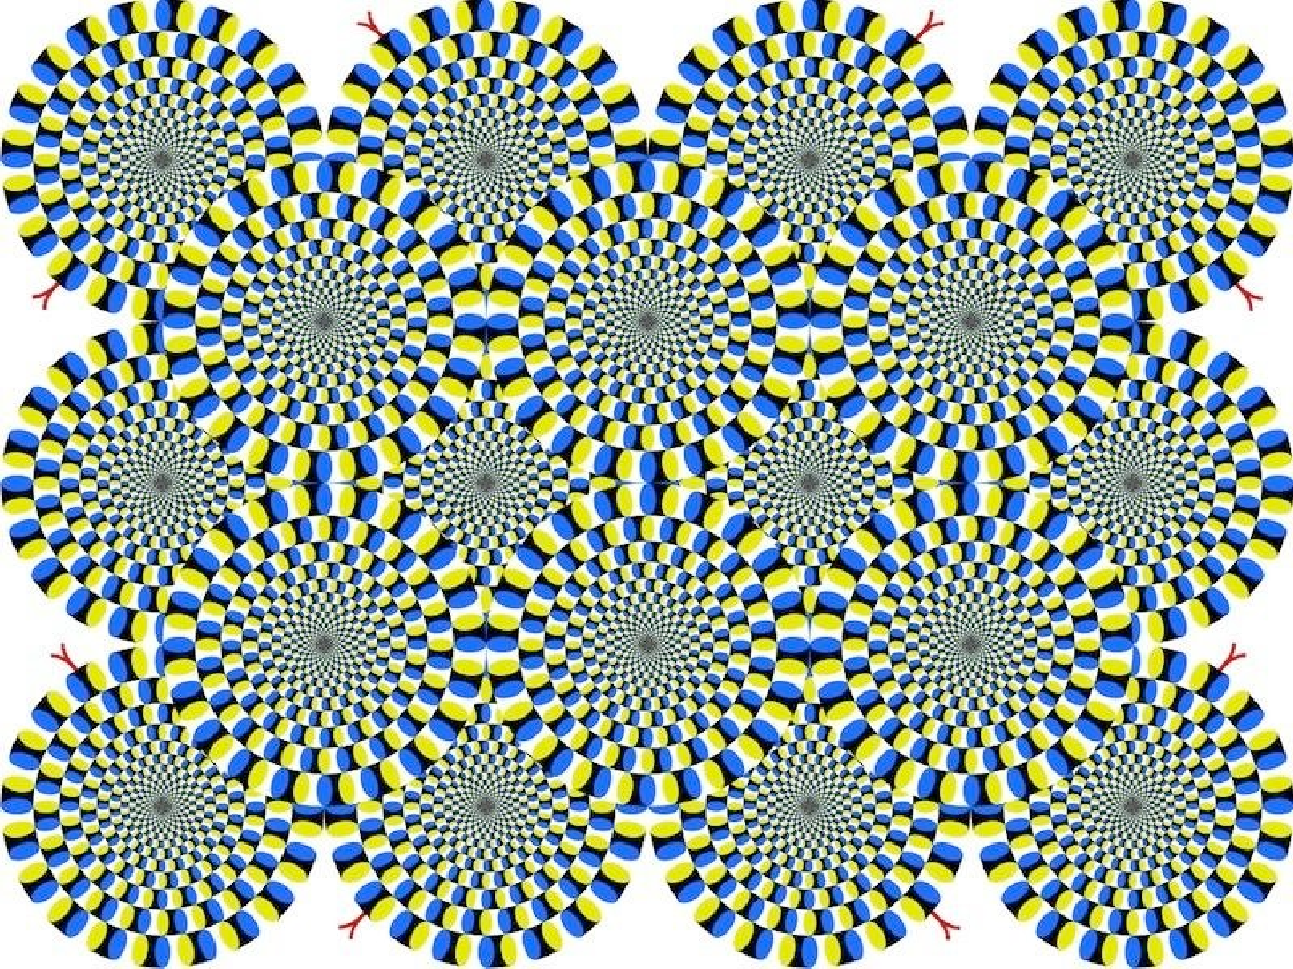

Slide 27
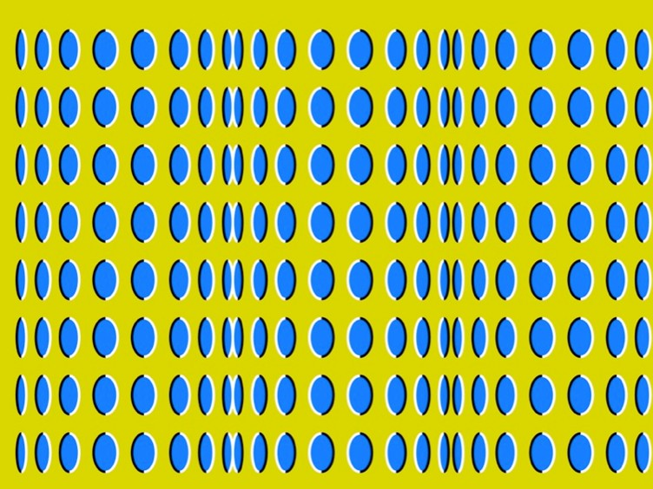

Slide 28
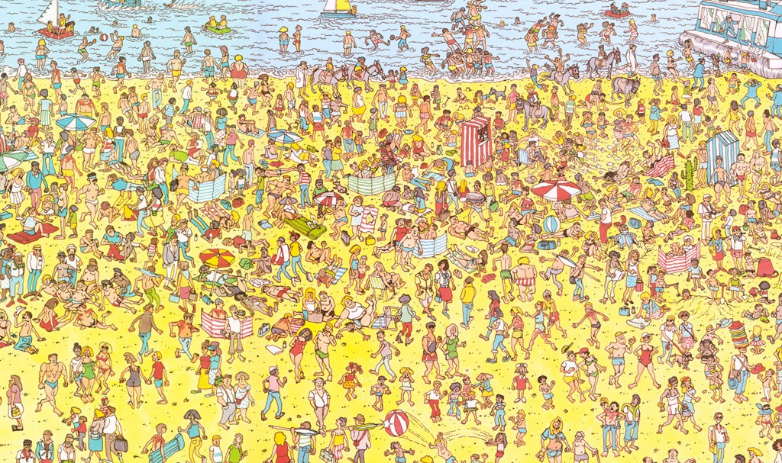
Some things are processed slowly

Slide 29
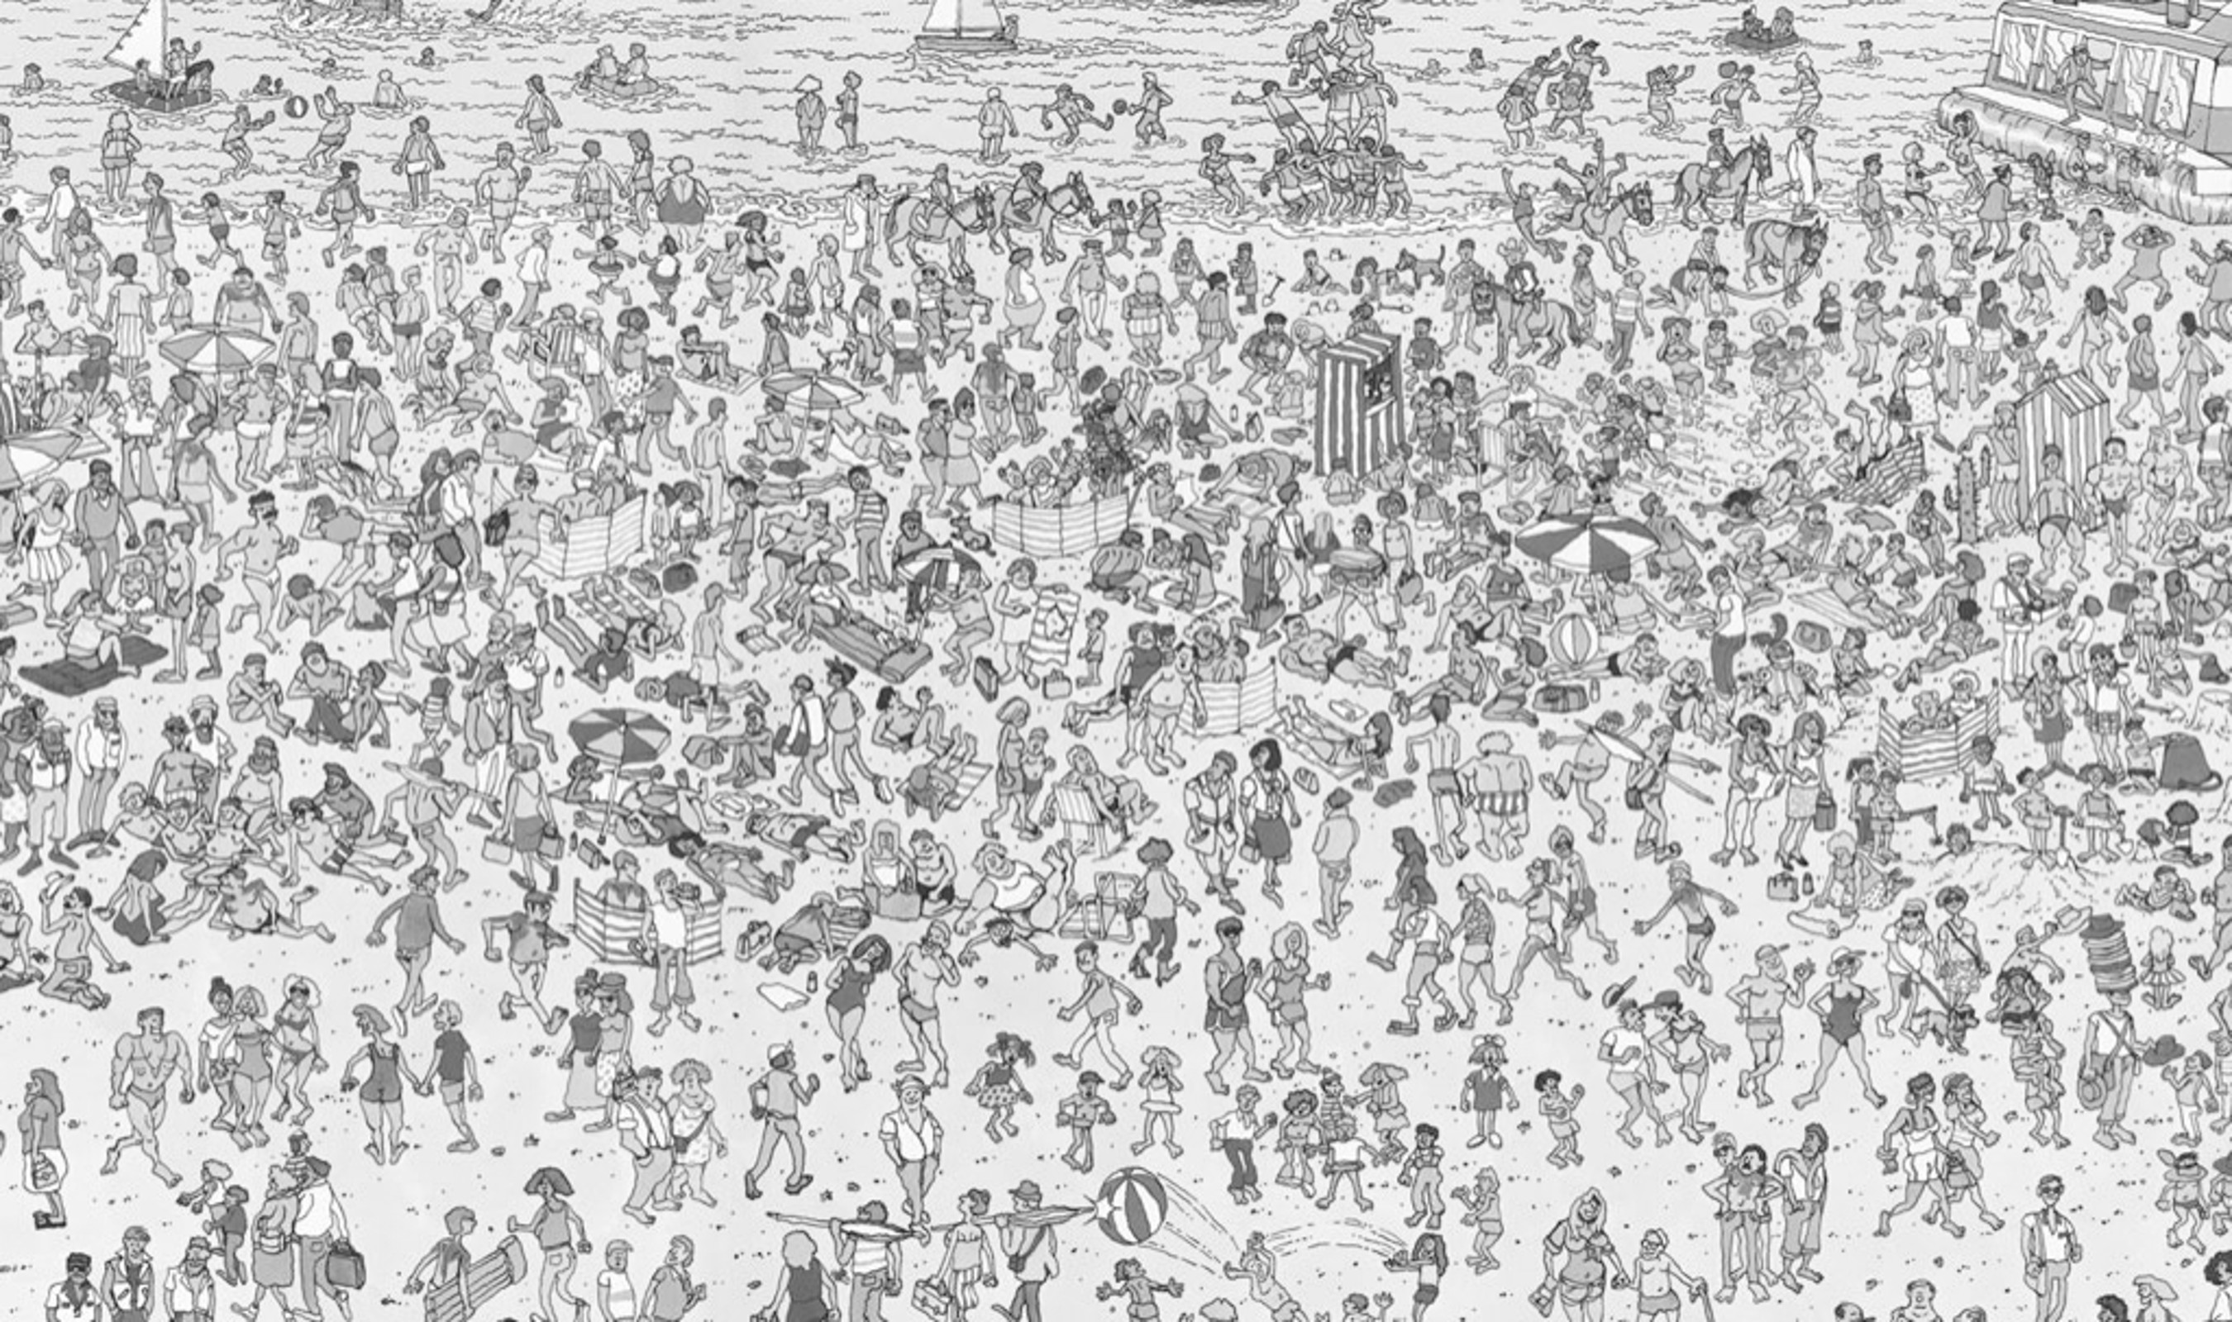

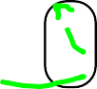

Others are incredibly fast

Slide 30
Fast = “pre-attentive processing”
Things that happen in <200ms of visual stimulation
Performed in parallel across the entire visual field
Example:

Slide 31
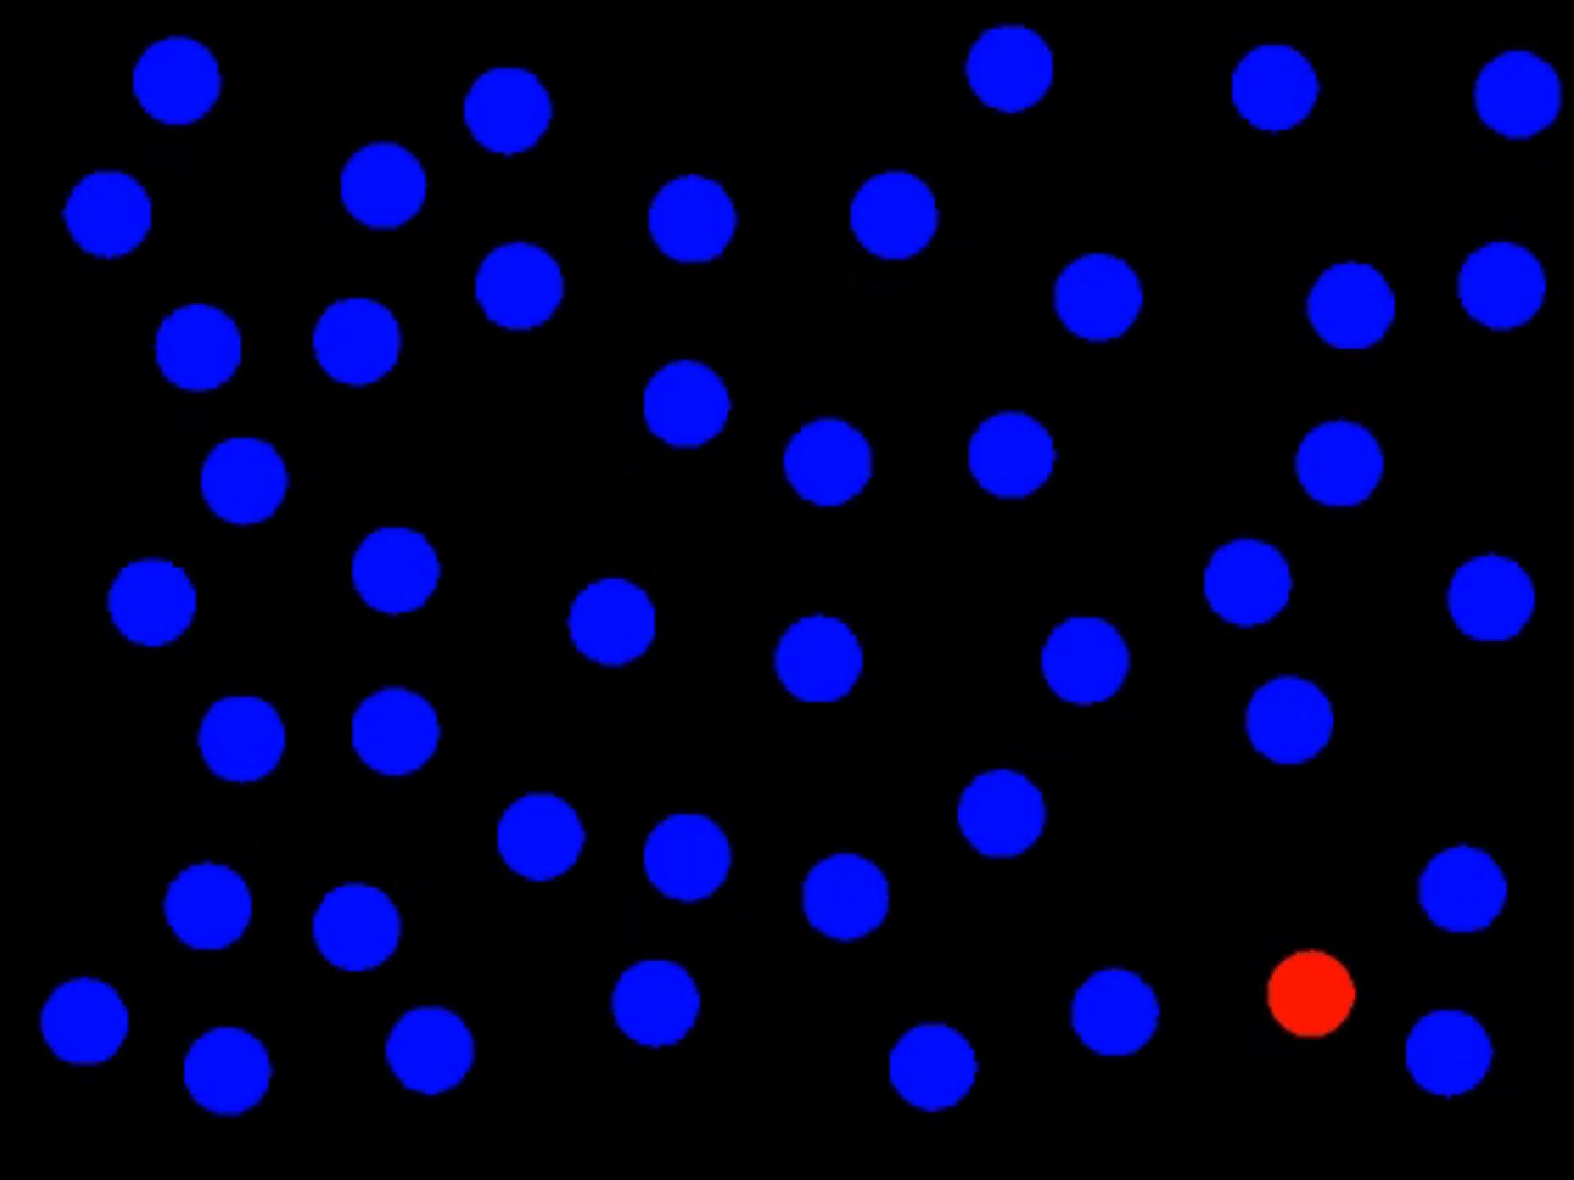
Perception: Preattentive Processing

Slide 32

What did you see?

Slide 33
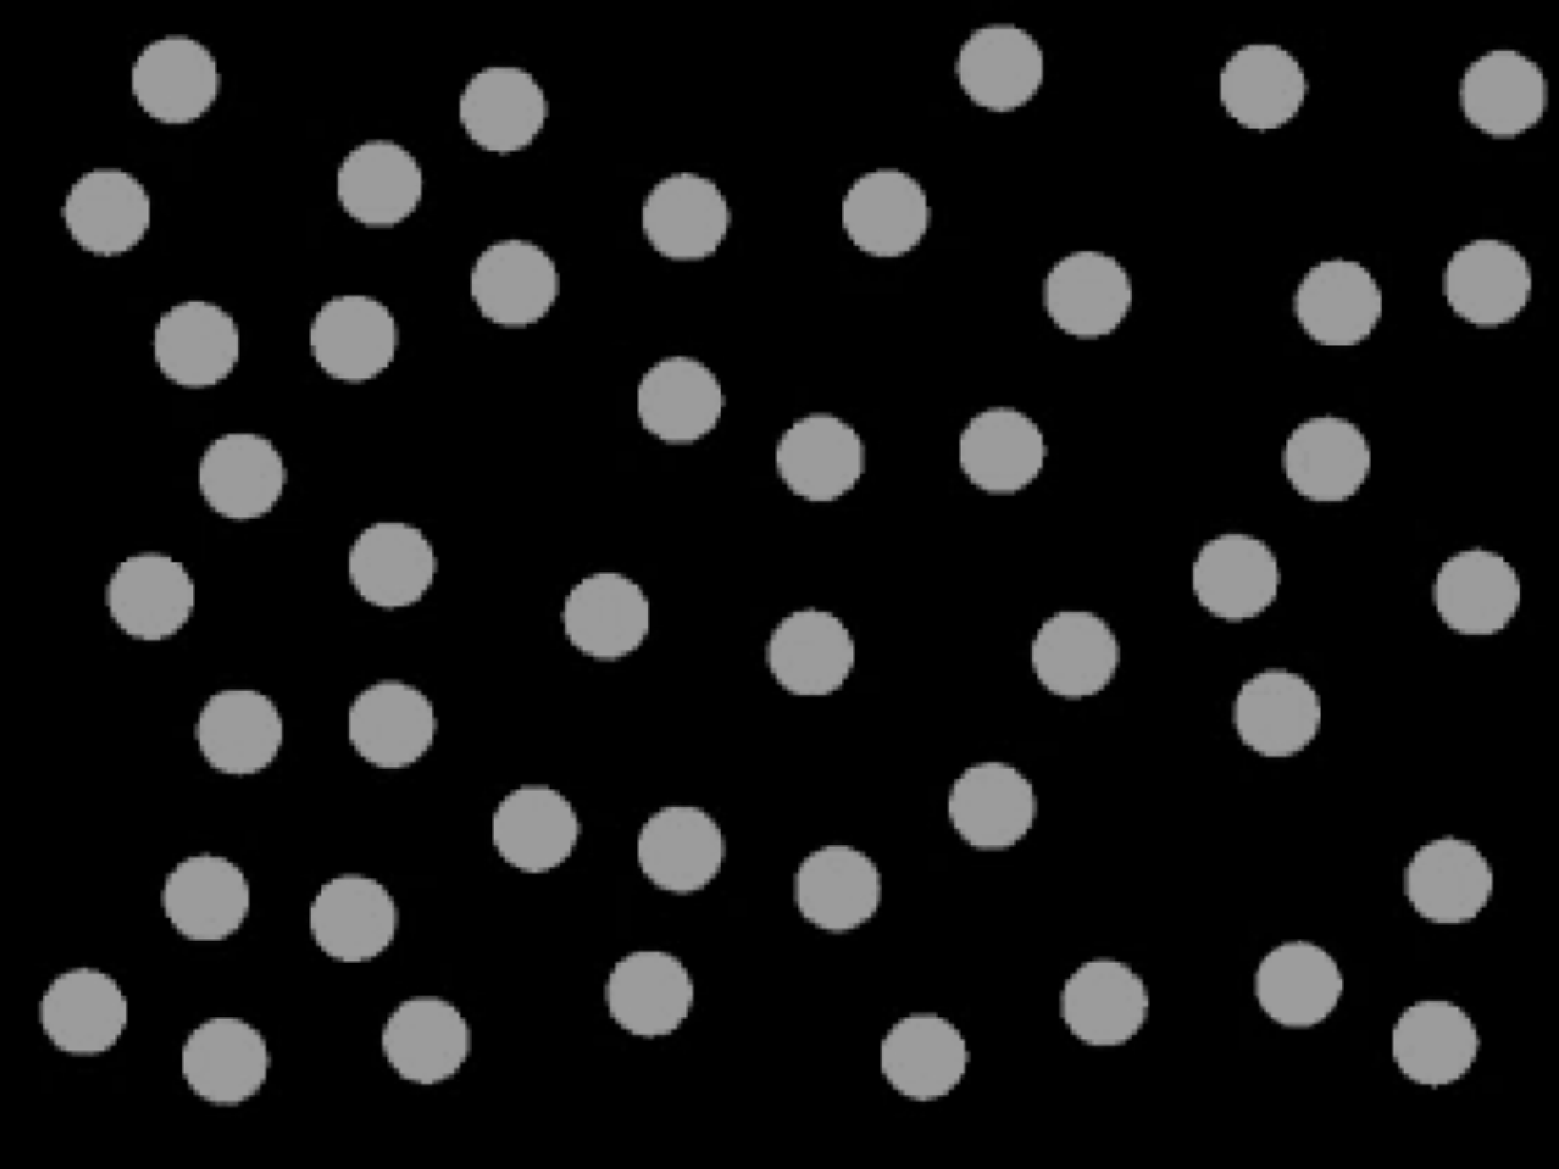

Perception: Preattentive Processing
RED DOT

Slide 34

BLUE DOTS

Slide 35
1
14
20
Perception: Preattentive Processing
36
5
4
2
9
13
8
19
35
34
3
7
12
18
25
33
6
11
32
10
17
40
24
31
BLUE DOTS
39
30
23
27
16
29
41
22
28
38
15
21
26
37
42

Slide 36
Pre-attentive processing facilitates:
Target detection (presence or absence)
Boundary detection / grouping
Region tracking
Counting and estimation

Slide 37
Attentive counting
1281768756138976546984506985604982826762
9809858458224509856458945098450980943585
9091030209905959595772564675050678904567
8845789809821677654876364908560912949686
How many threes are there?

Slide 38
Pre-attentive counting
1281768756138976546984506985604982826762
9809858458224509856458945098450980943585
9091030209905959595772564675050678904567
8845789809821677654876364908560912949686
How many threes are there?

Slide 39
Pre-attentive processing: color (hue)

Slide 40
Pre-attentive processing: shape (curvature)

Slide 41
Pre-attentive processing: shape + color?

Slide 42
Discussion: what’s going on here?
Answer: this is called “conjunction”
If you search for red things, you get a bunch of red circles (as well as the red triangle).
Similarly, if you search for search for triangles, you get a bunch of blue triangles (as well as the red triangle).
Either way, you have to search through them all one by one!

Slide 43

The “eyes” have it
Whatever draws our eyes draws our attention
This can be useful
It can also be problematic:

Slide 44

Can you see it now?
Whatever draws our eyes draws our attention
This can be useful
It can also be problematic:

Slide 45


Sometimes gestalt & pre-attention compete

Slide 46
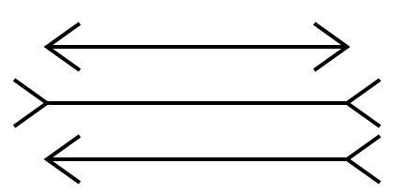
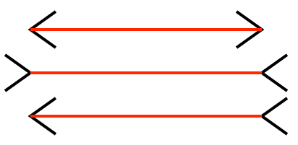
Sometimes gestalt & pre-attention compete

Slide 47
Magnitude estimation
Question: How much bigger is the lower bar?
Answer: 2x

Slide 48
Magnitude estimation
Question: How much bigger is the right square?
Answer: 4x

Slide 49
Magnitude estimation
Question: How much bigger is the left cube?
Answer: 27x

Slide 50

“Apparent” magnitude
Length
estimate
correctly
Area
under-
estimate
Actual
perfect correspondence
Volume
way under-
estimate
Perceived
http://makingmaps.net/2007/08/28/perceptual-scaling-of-map-symbols/

Slide 51

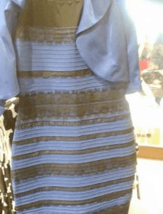

Color phenomena

Slide 52
Caveat 1: color is perceived in context
Which small square is darker green?

Slide 53


Caveat 2: difference is relative

Slide 54

Caveat 2a: so are brightness and contrast

Slide 55
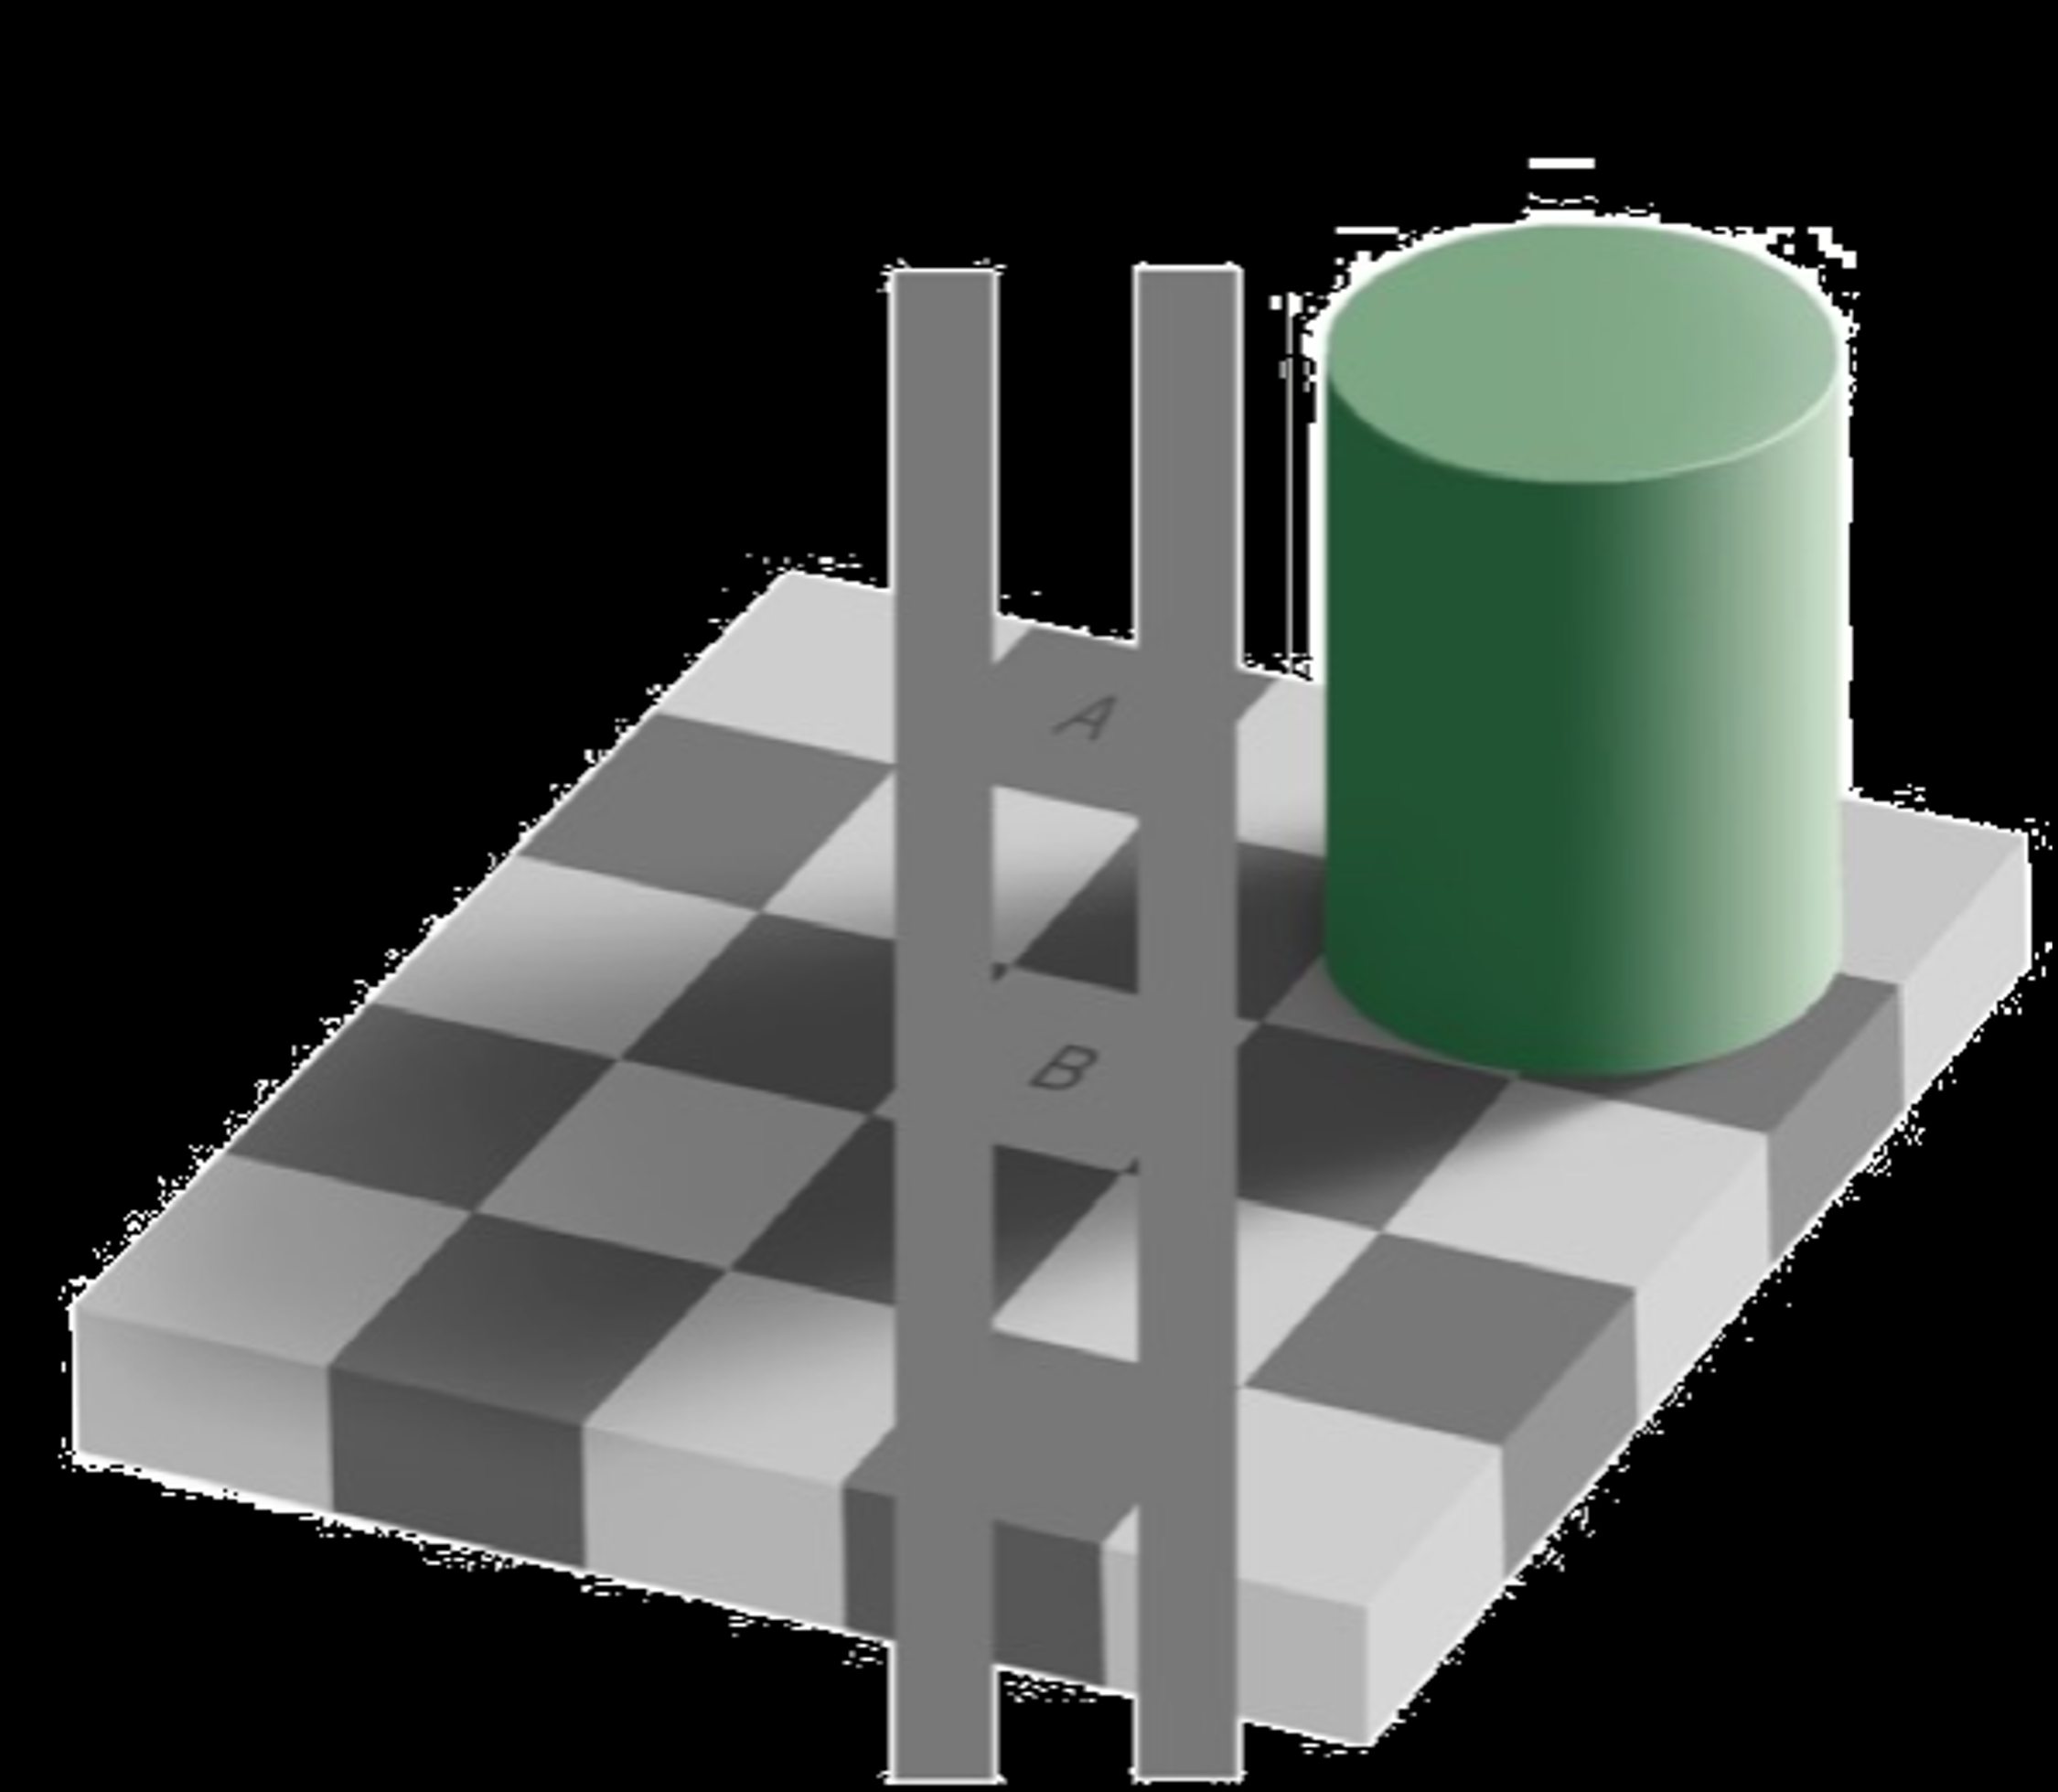
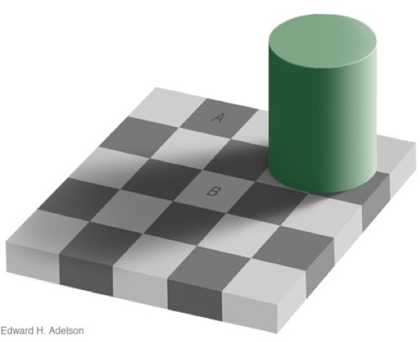

Caveat 3: mental models > perception

Slide 56
Takeaways
Visualization is more than just aesthetics
There are compelling cognitive reasons why some visualization techniques are helpful and others aren’t
The choices we make about visual mappings can have a significant effect on how people read visualizations

Slide 57

1st Assignment: Critical Reflection
Prompt: choose (or create!) a data visualization you find interesting or compelling, and explore how the design shapes or challenges the viewer’s mental model
Scope: ~1-2 pages (250 to 500 words), plus the visualization itself and any necessary references
Format:
A traditional “short paper” is fine
Medium.com article is also great (if you want something persistent)
Feeling creative? Annotated graphic, short video, etc. all fair game!
Due: March 2nd at 5pm EST on Moodle

Slide 58
Up next
Thursday 2/25: Data Wrangling and Modeling 101
Tuesday 3/2: Data Visualization 101

